Slide 1
Quiz 02
Draw the block diagram for Ciphertext stealing on the receiving end

Slide 2
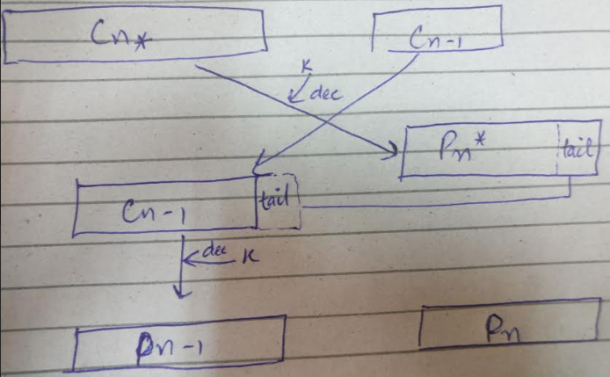
Solution
As we can see the C_{n*} shows the complete block that can be decrypted and C_{n-1} is the block that is missing its tail so it needs some bits that we borrow from C_{n-1} so that it can be decrypted. Thus we append the necessary bits and decypt both P_{n-1} and P_{n}. We should however note that P_{n} is of small size for encryption/decryption purposes.

